Slide 1

Chapter 4
Digital Transmission
4.<number>
Copyright © The McGraw-Hill Companies, Inc. Permission required for reproduction or display.

Slide 2
CONVERSION OF
DIGITAL DATA TO DIGITAL SIGNALS
In this section, we see how we can represent digital data by using digital signals.
The conversion involves three techniques: line coding, block coding, and scrambling. Line coding is always needed; block coding and scrambling may or may not be needed.
Topics discussed in this section:
Line Coding
Line Coding Schemes
Block Coding
Scrambling
4.<number>

Slide 3
Data Elements and Signal Elements
Common Characteristics are:
Data Element: Smallest entity – a bit that we want to send
Signal Element: Change in voltage or signal that moves on the wire
Signals carry Data on the network
      Data Elements: We want to send
      Signal Elements: What actually moves on the wires
4.<number>

Slide 4

Figure 4.1 Line coding and decoding
Line coding converts a sequence of bits to a digital signal
4.<number>

Slide 5

How many Signal elements to send data?
r = No of Data Elements / No of Signal Elements
4.<number>

Slide 6
Transmission of Digital Signals
Requird Bandwidth
Required bandwidth to send a digital signal in perfect shape is infinite
However digital signals can be sent in limited (finite) bandwidth over short distance
Poor quality (shape) at destination when it travels beyond 100 m
To send beyond 100m, use repeater (A switch) or use Broadband communication (convert to Analog)
4.<number>

Slide 7

What is “r” in Data Communication
“r” is defined as number of bits that can be sent in each signal change
r = No of Data Elements = No of Bits Sent
No of Signal Elements No of Signal Changes
r > 1 if more than 1 bit sent for every signal change
r = 1 if 1 bit sent for every signal change
r < 1 if less than 1 bit sent for every signal change
We can formulate the relationship between data rate and signal rate as
where N is the data rate (bps); c is the case factor, which varies for each case; S is the number of signal elements; and r is the previously defined factor.
4.<number>

Slide 8

Example 4.1
Q. A signal is carrying data in which one data element is encoded as one signal element ( r = 1). If the bit rate is 100 kbps, what is the average value of the baud rate if c is between 0 and 1 (=1/2)?
Solution
We assume that the average value of c is 1/2 . The baud rate is then
N = S x r
4.<number>

Slide 9
Signal Levels vs Bits per Level
A signal with L levels carries log₂L bits per level.
More levels, more bits per signal change
N = S x r x 1/c = B x r x 1/c
4.<number>

Slide 10
Bandwidth and Signal Rate
Larger the Bandwidth available, larger is the signal rate
Signal Rate S is measured in baud
Bandwidth is Directly Proportional to Baud Rate.
For higher data rate, larger bandwidth
Also more the number of levels, more bits carried per level
To get higher data rate, we make less signal changes by increasing the number of levels
4.<number>

Slide 11

Example 4.2
The maximum data rate of a channel is Nmax = 2 × B × log₂ L (defined by the Nyquist formula).
Calculate N for C=1/2
Solution
A signal with L levels actually can carry log₂L bits per level.
Every change in level results in a signal change (signal element)
When c = 1/2, then we have
4.<number>

Slide 12
Line Coding
Line Coding is the Process of converting digital data to digital signal
Data Could be Text, Numbers, Graphical Images, audio or video stored in memory as bits
At the sender the digital data is coded into digital signals
At the receiver the digital signals are decoded into digital data
There are lots of coding schemes, each one having very special characteristics and allow its use in very special situations
4.<number>

Slide 13

Line coding schemes
4.<number>

Slide 14
Characteristics of Line Coding Schemes
Relationship between Data Rate and Signal Rate
Bandwidth
Baseline Wandering
DC Component
Self Synchronization
Built-in Error Detection
Immunity to Noise and Interference
Complexity
4.<number>

Slide 15

Figure 4.5 Unipolar NRZ scheme
4.<number>

Slide 16

Polar
NRZ-L and NRZ-I schemes
Use two levels of voltage amplitude
In NRZ-L the level of the voltage determines the value of the bit.
In NRZ-I the inversion or the lack of inversion determines the value of the bit.
4.<number>

Slide 17
Example 4.4
A system is using NRZ-I to transfer 1-Mbps data. What are the average signal rate and minimum required bandwidth? (In book it is written 10 Mbps by mistake)
Solution
The average signal rate is S = N/2 = 500 kbaud. The minimum bandwidth for this average baud rate is Bmin = S = 500 kHz.
4.<number>

Slide 18

Polar RZ scheme
Uses three values: positive, negative, and zero
the signal changes not between bits but during the bit
requires two signal changes to encode a bit and therefore
occupies greater bandwidth.
4.<number>

Slide 19

Polar
Manchester and differential Manchester schemes
In Manchester and differential Manchester encoding, the change
at the middle of the bit results in good synchronization. Also has no DC Component Problem
4.<number>

Slide 20

Bipolar schemes
AMI and Pseudoternary
In bipolar encoding, we use three levels: positive, zero, and negative.
The voltage level for one data element is at zero, while
the voltage level for the other element alternates between
positive and negative.
AMI means alternate 1 inversion
A neutral zero voltage represents binary O
Binary Is are represented by alternating positive and negative
voltages. A variation of AMI encoding is called pseudoternary
4.<number>

Slide 21

Note
In mBnL schemes, a pattern of m data elements is encoded as a pattern of n signal elements in which 2^{m} ≤ L^{n}.
where m is the length of the binary pattern, B means binary data, n is the length of the signal pattern, and L is the number of levels in the signaling.
4.<number>

Slide 22

Multilevel Schemes: 2B1Q
2B1Q: Two Binary, One Quaternary (Two bits one level)
4.<number>
uses data patterns of size 2 and encodes the 2-bit patterns as one signal element belonging to a four-level signal

Slide 23
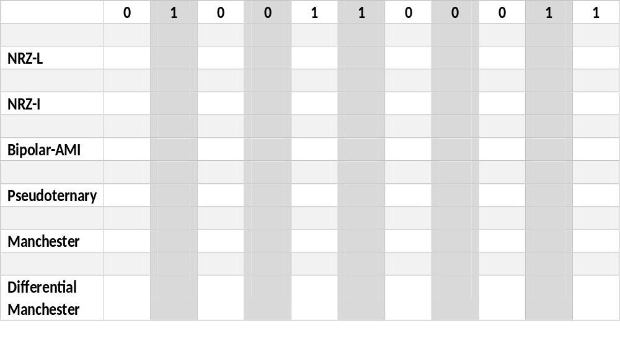
Review….
4.<number>

Slide 24

Multilevel Scheme : 8B6T
8B6T: 8 binary 6 Transitions
4.<number>

Slide 25
4-2 ANALOG-TO-DIGITAL CONVERSION
Transmission of digital signal is superior to an analog signal for quality transmission and better bandwidth utilization.
Thus changing an analog signal to digital data and then transmitting offers value
Two techniques used for converting Analog to Digital
1. Pulse Code Modulation (PCM)
2. Delta Modulation (DM)
4.<number>

Slide 26

Three Stages of PCM Encoder
2. Measure Voltage Level of each sample
1. Take Samples of Analog Signals at Twice the Highest Frequency
3. Convert Voltage Levels into 8 bit binary code
4.<number>

Slide 27
Note
According to the Nyquist theorem, the sampling rate must be at least 2 times the highest frequency contained in the signal.
4.<number>

Slide 28

Figure 4.24 Recovery of a sampled sine wave for different sampling rates
4.<number>

Slide 29
Example 4.9
Telephone companies digitize voice by assuming a maximum frequency of 4000 Hz. The sampling rate therefore is 8000 samples per second.
4.<number>

Slide 30
Example 4.10
A complex low-pass signal has a bandwidth of 200 kHz. What is the minimum sampling rate for this signal?
Solution
The bandwidth of a low-pass signal is between 0 and f, where f is the maximum frequency in the signal. Therefore, we can sample this signal at 2 times the highest frequency (200 kHz). The sampling rate is therefore 400,000 samples per second.
4.<number>

Slide 31
Example 4.11
A complex bandpass signal has a bandwidth of 200 kHz. What is the minimum sampling rate for this signal?
Solution
We cannot find the minimum sampling rate in this case because we do not know where the bandwidth starts or ends. We do not know the maximum frequency in the signal.
4.<number>

Slide 32

Example 4.14
We want to digitize the human voice. What is the bit rate, assuming 256 Levels, 8 bits per sample?
Solution
The human voice normally contains frequencies from 0 to 4000 Hz. So the sampling rate and bit rate are calculated as follows:
4.<number>

Slide 33

Components of a PCM decoder
First uses circuitry to convert the code words into a pulse that holds the amplitude until the next pulse.
After the staircase signal is completed, it is passed through a low-pass filter to smooth the staircase signal into an analog signal
4.<number>

Slide 34

Delta Modulation
Developed to reduce the complexity of PCM
PCM finds the value of the signal amplitude for each sample; DM finds the change from the previous sample
The process records the small positive or negative changes, called delta ∂.
process needs a base against which the analog signal is compared. The modulator builds a second signal that resembles a staircase.
4.<number>

Slide 35
Example 4.15
We have a low-pass analog signal of 4 kHz. If we send the analog signal, we need a channel with a minimum bandwidth of 4 kHz. If we digitize the signal and send 8 bits per sample, we need a channel with a minimum bandwidth of 8 × 4 kHz = 32 kHz.
4.<number>

Slide 36

Figure 4.29 Delta modulation components
Modulator, at each sampling interval, compares the value of the analog signal with the last value of the staircase signal. If the amplitude of the analog signal is larger, the next bit in the digital data is 1; otherwise, it is O. The output of the comparator, however, also makes the staircase itself. If the next bit is I, the staircase maker moves the last point of the staircase signal 0 up; if the next bit is 0, it moves it 0 down.
We need a delay unit to hold the staircase function for a period between two comparisons.
4.<number>

Slide 37

Figure 4.30 Delta demodulation components
The demodulator takes the digital data and, using the staircase maker and the delay unit, creates the analog signal.
The created analog signal, however, needs to pass through a low-pass filter for smoothing
4.<number>

Slide 38
4-3 TRANSMISSION MODES
Data across a link can be sent either parallel or serial mode.
In parallel mode, multiple bits are sent on multiple wires in parallel.
In serial mode, bits sent one after the other, There are three types of serial transmission:
    Asynchronous
    Synchronous
    Isochronous.
4.<number>

Slide 39

Figure 4.31 Data transmission and modes
4.<number>

Slide 40

Figure 4.32 Parallel transmission
Parallel transmission is a conceptually simple one: Use n wires to send n bits at one time.
That way each bit has its own wire, and all n bits of one group can be transmitted with each clock tick from one device to another
4.<number>

Slide 41

Figure 4.33 Serial transmission
4.<number>

Slide 42

Asynchronous Transmission
(Receiver synchronizes on Start and Stop Bits)
4.<number>

Slide 43
Synchronous Transmission
In synchronous transmission, we send bits one after another without start or stop bits or gaps.
It is the responsibility of the receiver to group the bits.
4.<number>

Slide 44

Synchronous Transmission
4.<number>

Slide 45

Effect of Non Synchronization
4.<number>

Slide 46
Example 4.3
In a digital transmission, the receiver clock is 0.1 percent faster than the sender clock. How many extra bits per second does the receiver receive if the data rate is
1 kbps? How many if the data rate is 1 Mbps?
Solution
At 1 kbps, the receiver receives 1001 bps instead of 1000 bps.
At 1 Mbps, the receiver receives 1,001,000 bps instead of 1,000,000 bps.
4.<number>

Slide 47
Case Factor “C” in Digital Communication: No. of 1s and 0s
Case 0. Our data can have all 1s 11111111 or all zero 00000000 that means no signal changes and we can send very large data in a limited bandwidth. We call this best case and define C=0
Case 1. We can have data continuously changing, i.e. 10101010, worst case, that means there will be signal changes every bit. We say C=1
Case Average: We assume data changes after every alternate bit, thus signal changes are half the number of bits. We say C=1/2
4.<number>

Slide 48
Typical Structure of Data Packets
Destination Address | Sender Address | Packet number | Total Packets | Data size | Data | Error Control Bits
4.<number>

